Slide 1
OOP
4 main concepts

Slide 2
4 main concepts
Encapsulation
Abstraction
Inheritance
Polymorphism

Slide 3
1. Encapsulation
Encapsulation is achieved when each object keeps its state private, inside a class. So, the object manages its own state via methods — and no other class can touch it unless explicitly allowed. If you want to communicate with the object, you should use the methods provided. But (by default), you can’t change the state.

Slide 4
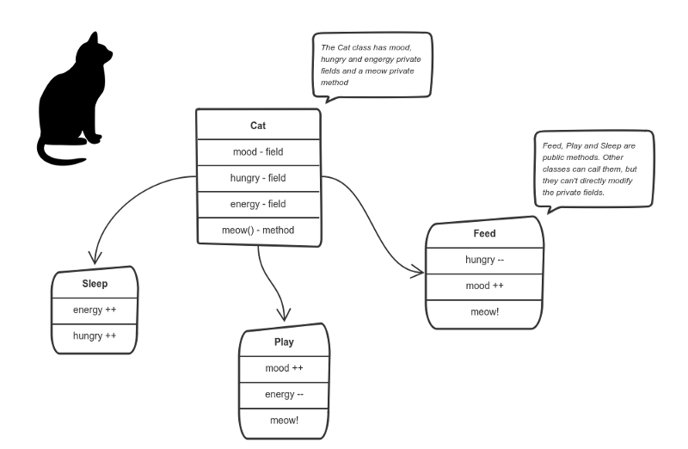
You can feed the cat. But you can’t directly change how hungry the cat is.

Slide 5
2. Abstraction
Abstraction is a concept aiming to ease this problem.
Applying abstraction means that each object should only expose a high-level mechanism for using it.
This mechanism should hide internal implementation details. It should only reveal operations relevant for the other objects.

Slide 6
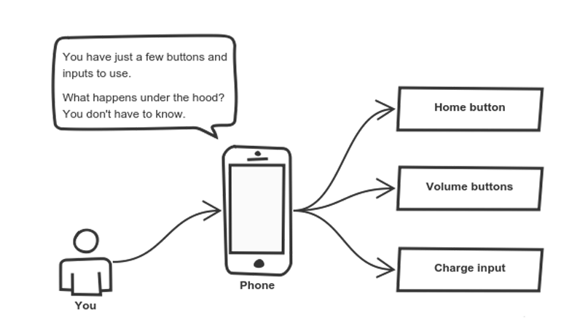
Cell phones are complex. But using them is simple.

Slide 7
3. Inheritance
Objects are often very similar. They share common logic. But they’re not entirely the same
So how do we reuse the common logic and extract the unique logic into a separate class? One way to achieve this is inheritance.
The child class reuses all fields and methods of the parent class (common part) and can implement its own (unique part).

Slide 8
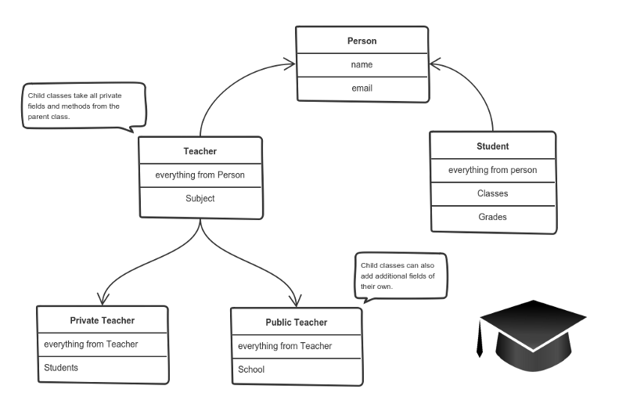
A private teacher is a type of teacher. And any teacher is a type of Person.

Slide 9
4. Polymorphism
Sometimes we want to use a collection — for example a list — which contains a mix of all these classes. Or we have a method implemented for the parent class — but we’d like to use it for the children, too.
This can be solved by using polymorphism.
Simply put, polymorphism gives a way to use a class exactly like its parent so there’s no confusion with mixing types. But each child class keeps its own methods as they are.

Slide 10
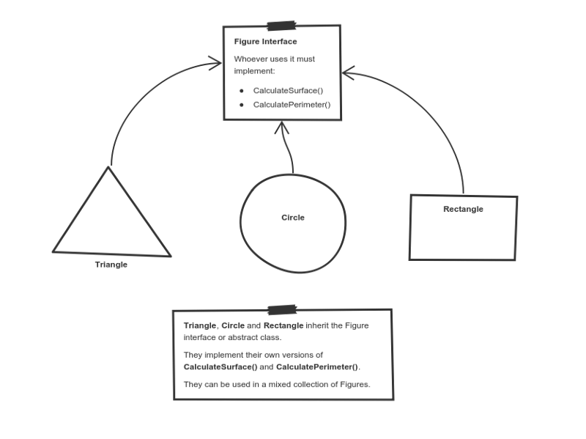
Triangle, Circle, and Rectangle now can be used in the same collection

